Slide 1
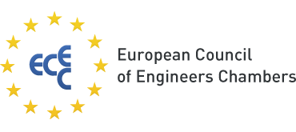
CRITICAL RAW MATERIALS
4th EUROPEAN ENGINEERS DAY
Brussels, 21 June 2022
Securing EU's open strategic autonomy the essential role of critical raw materials in the green and digital transition of EU industrial ecosystems
Dumitru Fornea
Member of EESC

Slide 2
Source: European Commission

Slide 3
2020 EC’s list of critical raw materials (new as compared to 2017 in bold)
Antimony | Hafnium | Phosphorus
Baryte | Heavy Rare Earth Elements | Scandium
Beryllium | Light Rare Earth Elements | Silicon metal
Bismuth | Indium | Tantalum
Borate | Magnesium | Tungsten
Cobalt | Natural graphite | Vanadium
Coking coal | Natural rubber | Bauxite
Fluorspar | Niobium | Lithium
Gallium | Platinum Group Metals | Titanium
Germanium | Phosphate rock | Strontium
Source: European Commission

Slide 5
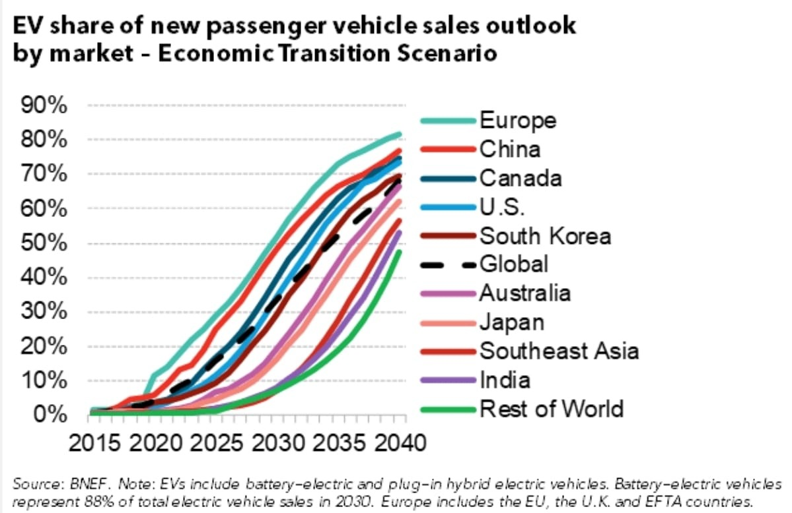
Bloomberg New Energy Finance
"There are 12 million passenger EVs, one million commercial EVs, and over 260 million electric two- and three-wheelers on the road globally today."
Electric Vehicle Outlook 2021, BloombergNEF

Slide 6
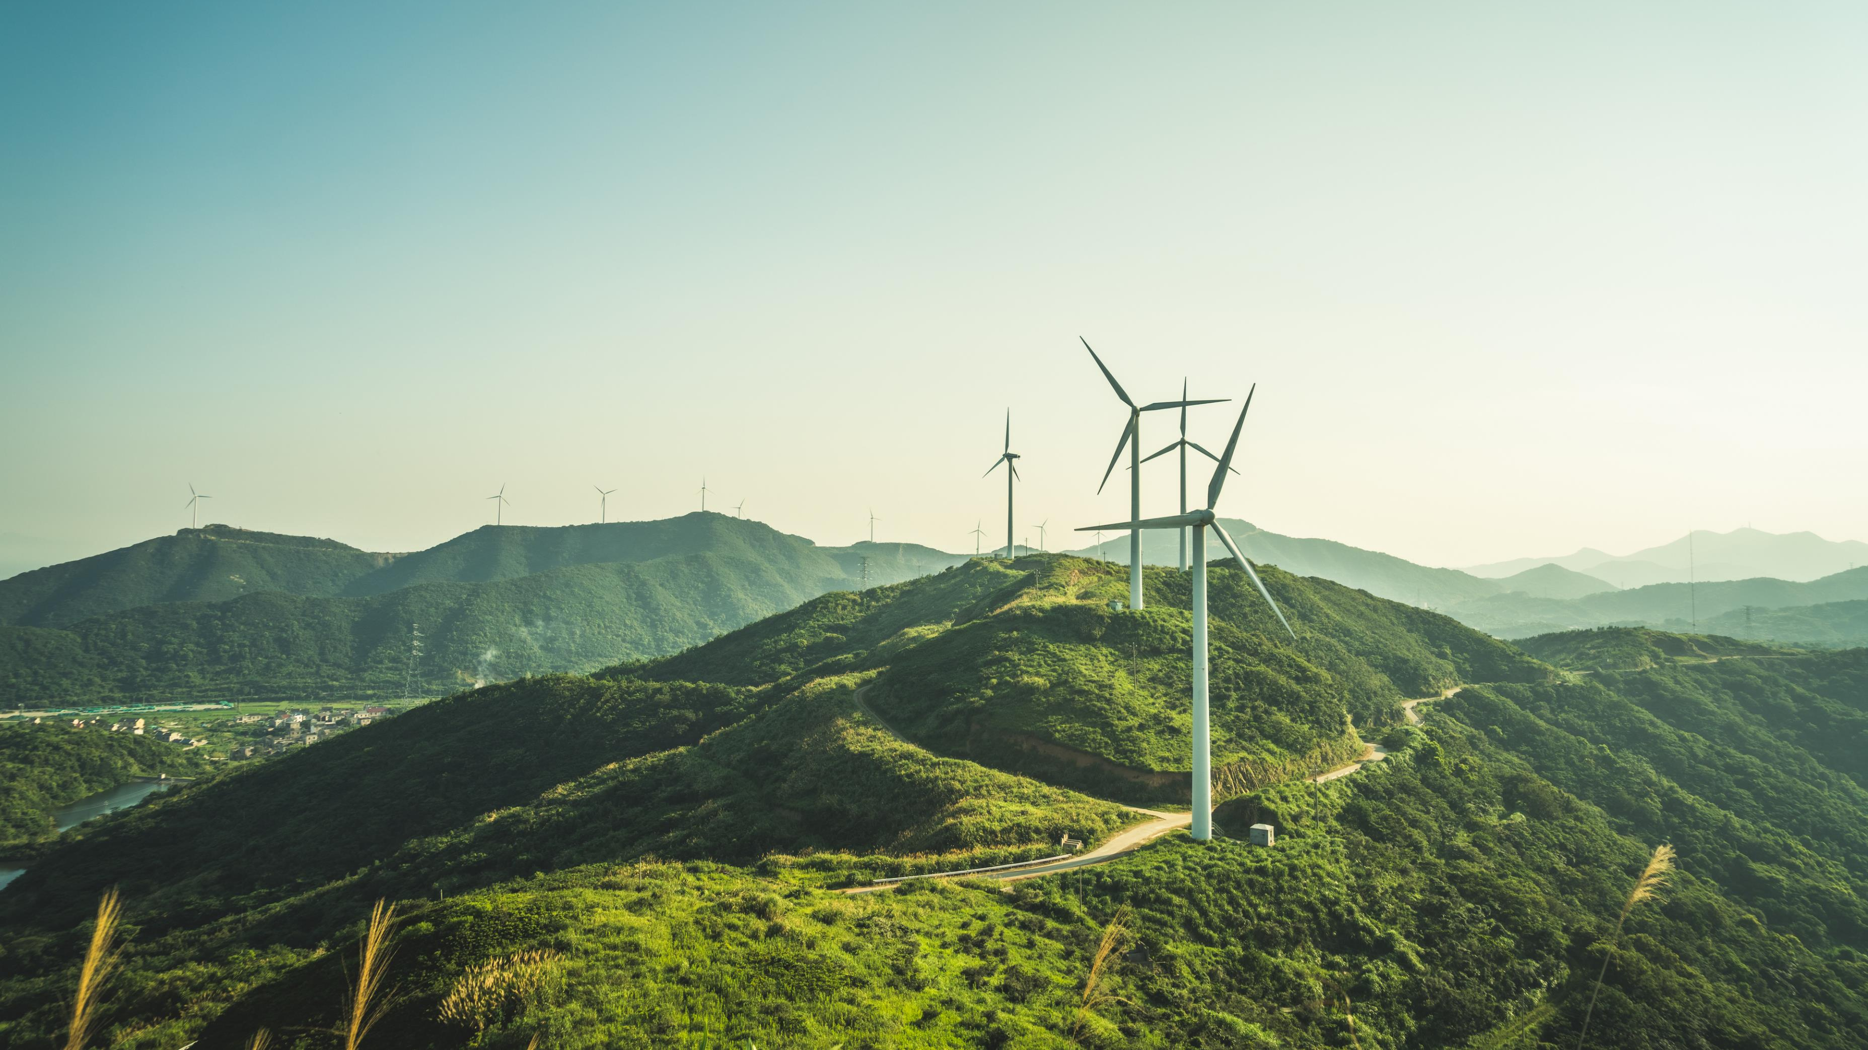
Each megawatt of energy from a wind generator requires between 600 and 1000 kg of permanent magnets made of iron - boron - neodymium alloys

Slide 7
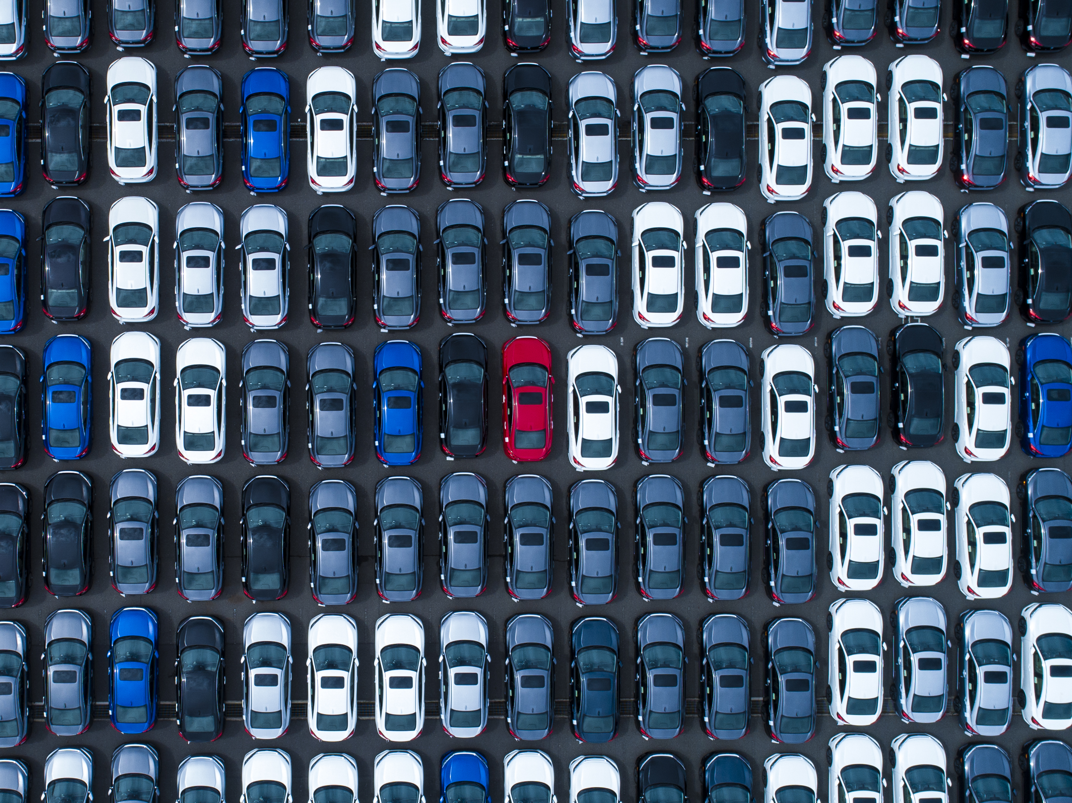
1 kg of neodymium is needed for the hybrid engine of a hybrid car 15 kg of lanthanum for the batteries of these cars

Slide 8
European Raw Materials Alliance 16,000 tonnes/year of rare earth magnets are imported by EU from China 98% of the EU’s needs

Slide 11
Country | Mine Production 2020 | Reserves | % of Total Reserves
China | 140,000 | 44,000,000 | 38.0%
Vietnam | 1,000 | 22,000,000 | 19.0%
Brazil | 1,000 | 21,000,000 | 18.1%
Russia | 2,700 | 12,000,000 | 10.4%
India | 3,000 | 6,900,000 | 6.0%
Australia | 17,000 | 4,100,000 | 3.5%
United States | 38,000 | 1,500,000 | 1.3%
Greenland | - | 1,500,000 | 1.3%
Tanzania | - | 890,000 | 0.8%
Canada | - | 830,000 | 0.7%
South Africa | - | 790,000 | 0.7%
Other Countries | 100 | 310,000 | 0.3%
Burma | 30,000 | N/A | N/A
Madagascar | 8,000 | N/A | N/A
Thailand | 2,000 | N/A | N/A
Burundi | 500 | N/A | N/A
World Total | 243,300 | 115,820,000 | 100%
Rare Earths Production and Reserves
Data: United States Geological Society (USGS)

Slide 12
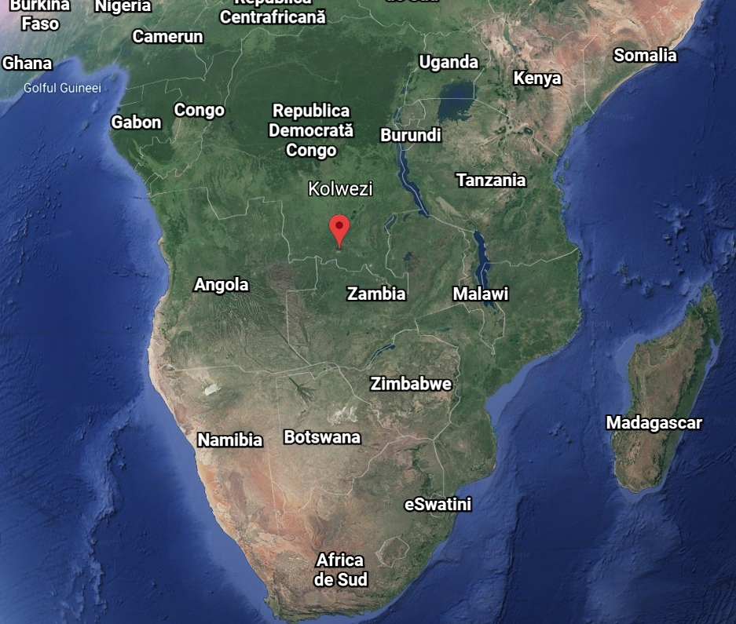
Kolwezi Mining Region - DRC

Slide 14
EU ACTIONS ON RAW MATERIALS
The European Institute of Innovation and Technology
The European Battery Alliance
The European Raw Materials Alliance

Slide 15
Raw Materials Diplomacy

Slide 16
“The Lithium project site spans a total surface area of 500 km2. This huge desert region, situated at an altitude of 3,800 m, is occasionally inhabited by around 15 people, the Puesteros. 50 km from there, the closest village, Santa Rosa de Pastos Grandes, has a population of 250.”

Slide 17
Global Gateway will mobilise up to €300 billion in investments in global infrastructure between
2021 and 2027

Slide 18
Den Svenska Gruvan (The Swedish Mine) is an initiative to spread knowledge about the Swedish mining industry and the Swedish mining cluster.

Slide 19
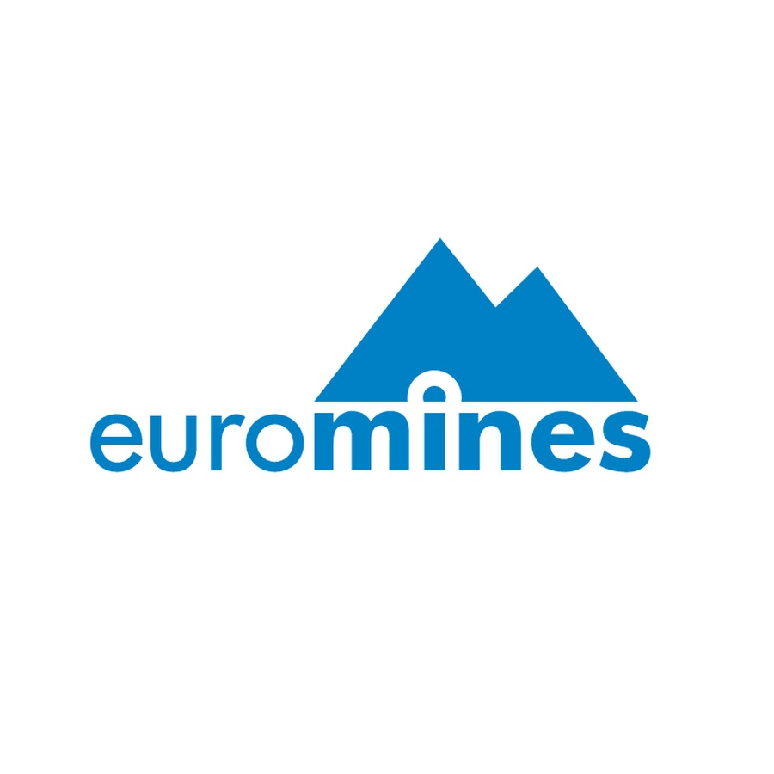
European Partnerships & Social Dialogue

Slide 21
Action Plan on Critical Raw Materials Technological Substitution

Slide 22
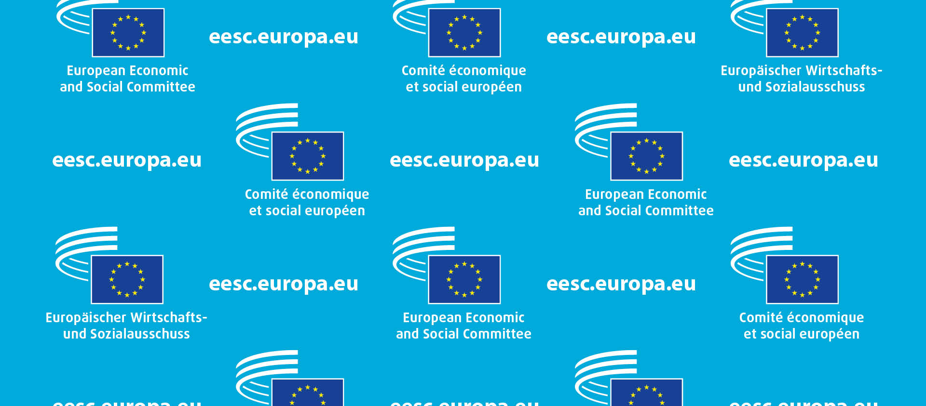
Thank you and see you soon !
Dumitru Fornea
Member of the European Economic and Social Committee

