Slide 1
Why women power is essential for the success of the NEB?
Blaženka Mičević, PhD
AGRODET Ltd founder & CEO
CLGE representative CRO

Slide 2
Few facts:
Engineering work is a basis for the functioning of all aspects of daily life,
There are over six million European Engineers that are active in a broad variety of Engineering branches,
In surveying sector:
The representation of women in surveying, in many countries, is significantly lower in relation to men
There is a frequent disparity in the salaries of women and men in surveying and an unequal starting position for male and women surveyors
Female don’t choose this occupation because of the stereotype that it is a „male“ occupation
There is a lack of women in leadership positions and a lack of surveyors who would be a role model for young people to choose this profession
Depending on branches and countries 15 - 30% of all engineers are women

Slide 3
CLGE Women in surveying project
Because of the:
salary gap,
gender stereotypes
non equal starting position for female and male surveyor entrepreneurs
lack of women role models in surveying
lack of women in leading position in surveying

Slide 4
CLGE Women in surveying project
VISION - To change the surveying sector and perspective of women in surveying through education, entrepreneurship and empowerment of women.
GOALS:
To educate the women surveyors in non surveyors field such as: marketing, sales, comunication, project management, enterpreneurship and self awerness,
To educate women surveyors in field of new technologies in STEAM industry
To define gender equality program policies in public and private sector
To define a program of mentoring and networking
To raise awerness about surveyors

Slide 5
But, in predominantly male sector, what ever sector it is,
IT’S NOT all in the data and numbers and how we will attract more women in this industry or decrease the pay gap
It is also about struggling, visibility, taking responsibility, self awerness, imposter sindrom and feeling „not good enough“

Slide 6
If in engineering „we are all the same” (same schools, colleges, degrees)
Why most of the women are struggling to be heard and seen?
Why most of the women don´t want to be on a stage, conference speakers, panelists, executive boards?
Why most of the women think that nobody will listen to what they have to say?

Slide 7
It is FEAR
It´s not a lack of proffesional knowledge
How many packages does a woman with something to say carry on her back in a backpack?

Slide 8
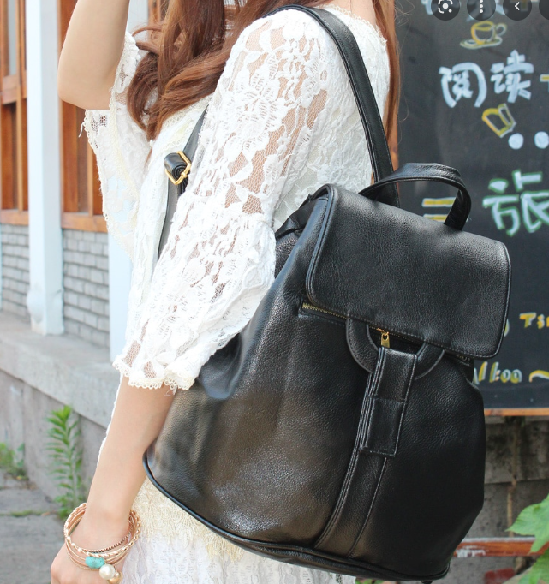
package of too fat, package of too skinny
lack of self-confidence package,
lacks of self-esteem package,
package of hard partner, package of bad relationship
Wich one is yours ?
package of Imposter syndrome
package I'm not good enough mother, wife, a package of uncooked lunch, a package of unwashed laundry
a package of unfulfilled expectations mostly from others
package of what will your mother say, package of what will your mother in law say
package I'm not good enough,
package She´s too beautiful to be smart,

Slide 9
For all the women with backpacks:
It´s not ABOUT you it´s about the people and society
You have the responsibility to share the knowledge you have
Don´t be inclusive for others but exclusive for yourself
„It is time of Premier League – time to play on the field not to sit on the bench”

Slide 10
Take the responsibility and Speak up
(your voice must be heard because of others)
You have an obligation
(to your knowledge, education, degrees, to your self)
This is no longer a individual’s issue
(it is not about you anymore)

Slide 11
Why women power is essential for the success of all the engineers?

Slide 12
Openness
Strength
Knowledge
Power
Inclusivnes
Team work
Empathy
Communication
Sharing
Responsibility
Leadership
Vulnerability
Motivation
Planning
Clarity
Caring
Encouragement
Understanding
Stability
Relations

Slide 13
Synergy
Only than the NEB will be successful

Slide 14
Be supportive, be inclusive!
THANK YOU!
blazenka.micevic@agrodet.hr

