Slide 1
European Professional Card Steering Group Meeting – 25 February 2011

Slide 2
Structure of the Presentation :
Answers to the 10 Questions – 1st Steering Group Meeting
FEANI Professional Card, i.e. the “EngineerING card”
- concept and design - process of application - organisation and authorities - status February 2011

Slide 3
Discussion points of Steering Group
Question 1 : Added Value of a European Professional Card – What problems could it solve ?

Slide 4
Added value :
discussion points
Become a reliability label for Professional Groups
Speed up the recognition procedure and cost savings
Recruitment tool for employers who will be gaining time
Ensure increased transparency on the job market
Advantages for the European economic area in terms of mobility of professionals

Slide 5
Discussion points of Steering Group
Question 2 : A common format of the professional card for all professions or integrate some specific elements for certain professions ?

Slide 6
Common format :
discussion points
The benefit of standardization is not obvious for all professional groups
Each professional group must determine which qualifications are best documented
Example : « engineers » versus « tourist guides »

Slide 7
Discussion points of Steering Group
Question 3 : In which situations should the card be used and what would be the legal effects ? Must the card be obligatory for professionals ?

Slide 8
Use of the card :
discussion points
Benefit will not be as high in professions in which automatic recognition already exists (as compared to other professions)
FEANI sees no distinction in « temporary mobility » and « establishment » in terms of security and/or quality of the work to be done : such distinction makes no sense

Slide 9
Discussion points of Steering Group
Question 4 : How cold the professional card work in cases of mobility between non-regulating and regulating Member States ?

Slide 10
Regulating/non-regulating states :
discussion points
It will be quicker and easier for the competent authorities to decide if the requirements imposed by national law have been satisfied or not – if not : compensation measures.

Slide 11
Discussion points of Steering Group
Question 5 : How to link the card with European and national existing law ? Develop the card under the current directive or in the context of the modernisation of the directive ?

Slide 12
Link with European and existing law :
discussion points
That the qualifications on the card should be recognised throughout Europe, should be stipulated at European level.
The actual configuration of the card should be left to national professional organisations.
Compliance with national laws and regulations is a matter of the relevant authorities in each country.

Slide 13
Discussion points of Steering Group
Question 6 : Link with the European Qualifications Framework and with a competency-based approach.

Slide 14
EU Qualifications Framework :
discussion points
European standards for classification should definitely be taken into account.
EngineerING-card complies to EQF-criteria 6, 7 and 8 = a European standard for the classification of professional qualifications.

Slide 15
Discussion points of Steering Group
Question 7 : Who should issue the card ? Is the competent authority of the Home Member State best placed ? What would be the costs of such a card ?

Slide 16
Competent Authorities and Costs :
discussion points
At least for the EngineerING profession the card should be issued by the competent national professional organisation in each country.
These are best-placed to assess the relevant qualifications of an applicant and to classify them against EQF.
Application fee should be determined at national level.

Slide 17
Discussion points of Steering Group
Question 8 : What information is necessary for issuing the card ? What should be present on the card ? What should be the period of validity of the card and how to up-date regularly. Is there a need for a database.

Slide 18
What kind of Information ? What Validity ? Which Database ?
discussion points
All qualifications of relevance to the profession :
e.g. for engineers this relates to :
Education
Professional experience
CPD
Valid for 10 years, update at any time.
Plastic card without chip at present, with link to a national registry database.

Slide 19
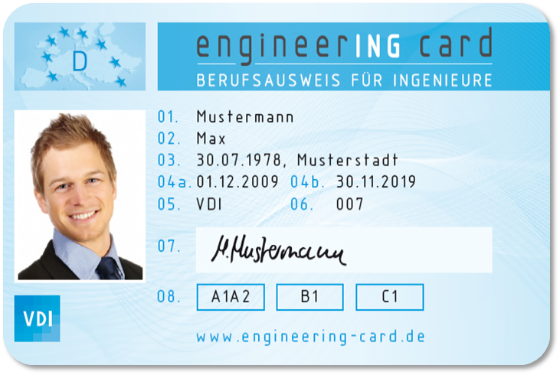
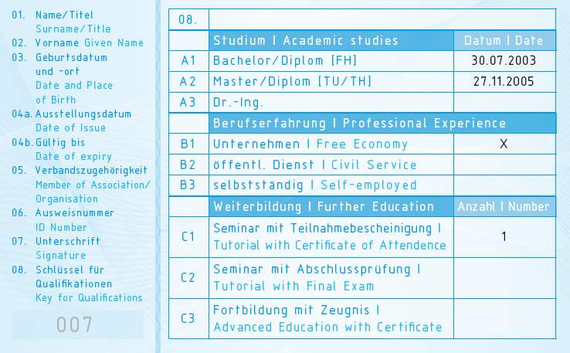
Design
ENGINEERING CARD

Slide 20
Education: academic studies
ENGINEERING CARD
A1 Bachelor, short cycle
A2 Master, long cycle
A3 PhD, doctoral degree
in accordance with the European Qualifications Framework
in line with EUR-ACE Framework and/or FEANI-Index-criteria

Slide 21
Professional experience
ENGINEERING CARD
B1 industry/free economy
B2 public service
B3 self-employed
documented for at least two years

Slide 22
Training: CPD – further education
ENGINEERING CARD
C1 training/seminars with attendance certificate
C2 training/seminars with final examination
C3 continuing education with examination and degree
recognition of continuous professional development
certificates are not a requirement for obtaining the card

Slide 23
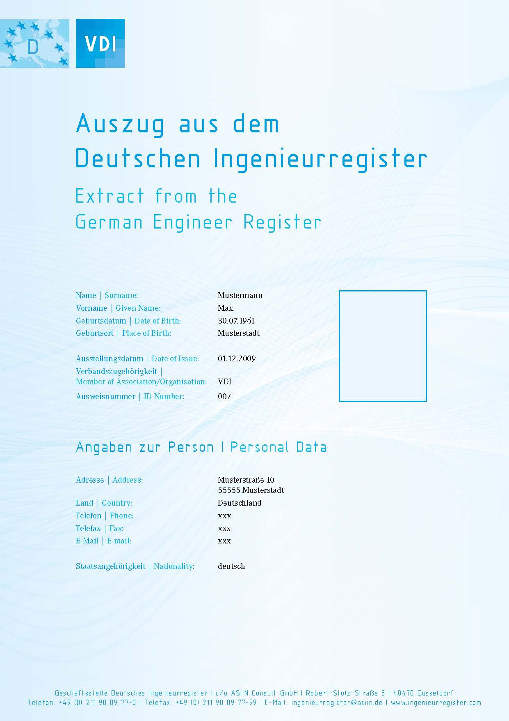
Registration in the National Engineering Register
ENGINEERING CARD

Slide 24
Discussion points of Steering Group
Question 9 : Could a professional card be developed only in the long term or in the short term ?

Slide 25
Development in the Long or Short term
discussion points
Significant preparatory work done by individual professional engineering associations already since 2005.
FEANI developed the EngineerING card in full within one year – unanimous approval by GA (31 countries) in October 2010.
Implementation in the short term is surely possible (expected are 5 to 10 countries to start in the course of 2011).

Slide 26
Discussion points of Steering Group
Question 10 : What must be the format of the card ? Which languages should the card be delivered ?

Slide 27
Format and Languages
discussion points
See previous answers : plastic card in combination with national register entry
Bilingual: language of the country of issue and English

Slide 28
EngineerING card
IN CONCLUSION:

Slide 29
EngineerING card : five major characteristics
ENGINEERING CARD
Complete and Comprehensive: education, professional experience, CPD training
Standardized : based on EQF
Reliable : verification in the country of origin by an independent commission which ensures wide recognition
Decentralized : administration of the professional card is the responsibility of the respective EU Member State – leaving room for country specific additions
Voluntary : no engineer is obliged to hold a card, it is a service to any engineer who wishes to be internationally mobile.

Slide 30
Authority, decentralised organisation
ENGINEERING CARD
National Register Committee
defines national implementation of European standards
decides on acceptance and issues the engineerING card
compiles a national engineering register (database)
FEANI Register Commission
defines standards, quality assurance, monitoring
compiles a list of all issued cards
establishes board of complaint

Slide 31
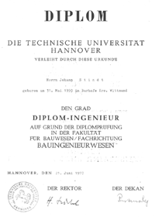
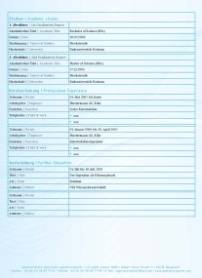
Process of application :
ENGINEERING CARD
application, submission of diplomas and certificates
verification, acceptance by national register committee
alignment with FEANI-List
acceptance into national engineer register

Slide 32
Implementation – status Feb 2011
ENGINEERING CARD
Detailed FEANI Guidelines are approved
Process and Rules of acceptance / verification are defined
Register Commission (3 to 15 persons) will be defined
Several countries are in the process to implement the card

Slide 33
FEANI calls on the political world to:
discussion points
create a suitable framework through revision of 2005/36/EC
explicitly acknowledge the engineerING card in the Directive
professional cards will simplify cross-border employment and mobility

Slide 34
Thank you for your attention

